Slide 1

Optimizing City General Hospital Operations
Presented by Blessing Shantel Nochiri, Data Analyst

Slide 2
Problem Summary: Addressing Critical Challenges at City General
Capacity & Patient Flow
Workforce Imbalance
Inventory Mismanagement
Unexplained patient surge overwhelming the ER, compounded by a demographic mismatch (elderly patients vs. teen-prepared beds), leading to admission backlogs.
Severe staffing mismanagement, with dangerous overwork for some doctors (40 patients in two days) while others remain underutilized.
Pharmacy ordering errors result in essential medication stockouts and excess expiring Penicillin (500 boxes).
Financial Leakage
Lab Operational Inefficiency
Despite high patient volume, the hospital is losing money due to improper insurance payments and a lack of visibility into unprofitable treatments.
A 15% re-test rate for inconclusive results doubles workload and slows hospital operations.

Slide 3

Key Objectives: Guiding Our Analysis
Patient Demographics
Determine the age group distribution of our patient population.
Billing & Insurance
Analyze the average billing amount received from insurance providers.
Length of Stay (LOS)
Identify top doctors associated with patients experiencing long lengths of stay, and understand LOS distribution by admission type.
Medication Trends
Uncover the most frequently prescribed medications over time and their associated medical conditions.
Lab Test Quality
Evaluate the proportion of abnormal, normal, and inconclusive test results to pinpoint quality issues.

Slide 4
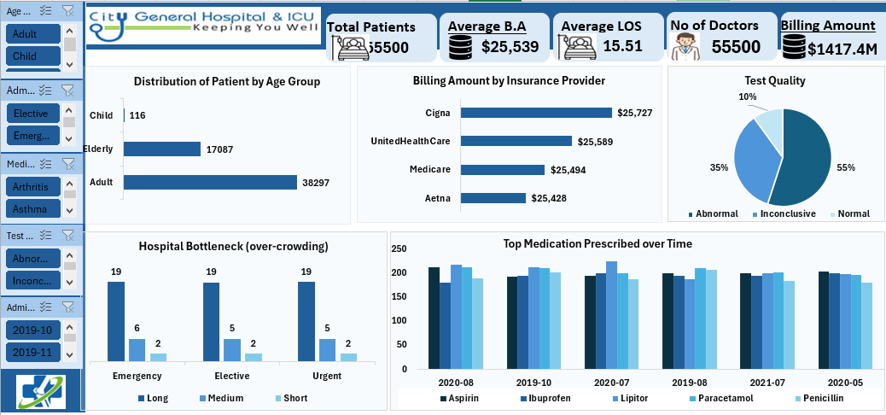

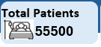


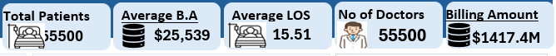




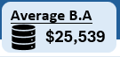


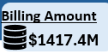

Key Performance Indicators (KPIs)
Total Patients
Total Doctors
Avg. Length of
Stay
Avg. Billing
Amount
Sum Billing
Amount

Slide 5
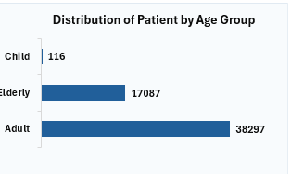
Patient Demographics: Age Group Distribution
Our analysis reveals a
significant shift in patient
demographics, with a
higher-than-expected influx
of elderly patients.
This finding directly impacts
bed allocation and
specialized care
requirements.
This demographic trend necessitates a re-evaluation of resource allocation and specialized care services to adequately meet the needs of our patient population.

Slide 6

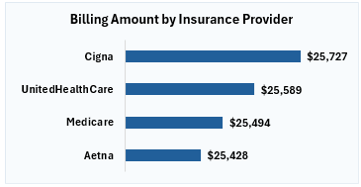
Billing Amount by Insurance Providers
Understanding billing performance
across different insurance providers is
crucial for addressing financial leakage. Our findings highlight discrepancies in payment amounts.
Further investigation into payment disparities and contract terms is recommended to optimize revenue collection.

Slide 7



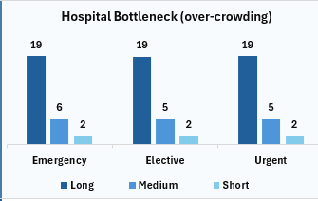


Hospital Bottleneck: Length of Stay Analysis
Long lengths of stay (LOS) contribute significantly to ER overcrowding and bed shortages. Our analysis identifies patterns related to specific doctors and admission types.
Impact on Capacity
Extended LOS directly reduces bed availability, exacerbating the patient flow crisis.
Top Doctors with Long LOS
Identifying physicians whose patients consistently have extended stays is key to process improvement.

Slide 8
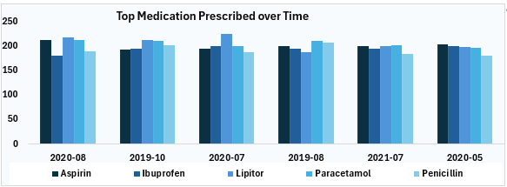


Inventory Stock Management: Pharmacy Inefficiencies
Inefficient pharmacy operations directly impact patient care and financial health. Our investigation uncovers critical issues in inventory management.
Essential Stockouts
Failure to order critical medications leads to shortages, affecting patient treatment.
Expiring Stock
Excess inventory of medications like Penicillin nearing expiration represents significant waste.
Implementing a robust inventory tracking system is paramount to rectify these challenges.
Inaccurate Ordering
Systemic issues in the ordering process contribute to both shortages and overstocking.

Slide 9
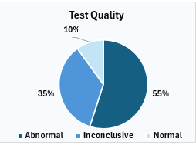
Lab Test Quality: Addressing Inconclusive Results
The high re-test rate in the laboratory is a major driver of operational inefficiency and increased workload.
Initial Test
Inconclusive Result
Patient sample undergoes initial laboratory analysis.
15% of tests yield results that cannot be definitively interpreted.
Extended Diagnosis
Required Re-Test
Delays in diagnosis and treatment due to prolonged lab processing.
Inconclusive results necessitate a complete re-run, doubling the effort.
Investigating root causes, such as equipment calibration or staff training, is crucial to reduce this costly re-test rate.

Slide 10


Summary of Findings & Recommendations
Demographic Shift
Elderly patient surge requires re-evaluation of bed capacity
and specialized care.
LOS & Bottlenecks
Target interventions for high LOS physicians and specific
admission types.
Pharmacy Overhaul
Implement advanced inventory management to prevent
stockouts and waste.
Financial Optimization
Deep dive into insurance payment discrepancies and
treatment profitability.
Lab Quality Initiative
Address the 15% re-test rate through process
improvements and training.
By addressing these critical areas, City General Hospital can
significantly improve operational efficiency, patient care, and financial
health.

Slide 11
Recommendations
1. Implement Predictive Capacity Planning
The hospital prepared beds for teenagers, but the surge consisted of elderly patients , causing a chain reaction that blocked the ER.
Recommendation: We must analyze historical admission data to identify seasonal trends and demographic shifts. By creating a predictive model, we can forecast patient surges and age demographics accurately.
The goal is to ensure bed allocation matches the actual incoming patient profile (geriatric vs. pediatric) to prevent hallway backlogs.
2. Optimize Workforce Allocation (Load Balancing)
There is a severe imbalance where some doctors see 40 patients in two days , while others are relaxed and sipping coffee.
Recommendation: Conduct a "Time and Motion" study using the staffing data. We need to correlate staff schedules with peak patient arrival times.
The goal is to Implement dynamic scheduling to redistribute the workload fairly, reducing burnout for the overworked staff and utilizing the idle capacity of others.
3. Data-Driven Inventory Management
The pharmacy is ordering the wrong items, leading to stockouts of essentials while 500 boxes of Penicillin expire.
Recommendation: Perform an ABC Analysis on inventory data to classify high-value and high-turnover drugs. We must set up automated reorder points based on actual consumption rates rather than static standing orders.
The goal is to Reduce waste (expired drugs) and ensure critical medications are always in stock.

Slide 12
4. Revenue Cycle & Cost Analysis
The hospital is full but losing money because insurance isn't paying properly and loss-making treatments are unidentified.
Recommendation: Audit the billing data to identify the specific "treatments causing losses". We must also analyze insurance claim denial codes to understand why payments are being withheld.
The goal is to Plug revenue leaks by renegotiating insurance contracts or adjusting pricing for loss-making treatments.
5. Laboratory Quality Control Audit
A 15% re-test rate due to inconclusive results is doubling the workload.
Recommendation: Isolate the data on the inconclusive tests. Is it a specific machine? A specific technician? Or a specific type of test?
The goal is to Identify the root cause of the errors to bring the re-test rate down to industry standards, immediately freeing up 15% of the lab's capacity.

Slide 13
Conclusion
City General is currently facing a systemic failure where "resources
are poorly managed" and the leadership has "no story, no
explanation, no clarity". The core issue is not necessarily a lack of
resources, but a misalignment of those resources against actual
demand.
By mining the years of information currently sitting on the hard
drive , we can stop the "chain reaction" of inefficiency. The
priority is to move from reactive panic—where Dr. Sarah is putting
her head in her hands —to proactive management, ensuring that
the hospital stops losing money and staff stop suffering from
burnout.

Slide 14
Thank You

